Slide 1
Ashesi University department of business administration BUSA 224: Finance for non-finance managers
Course Faculty:
A. Alu

Slide 2
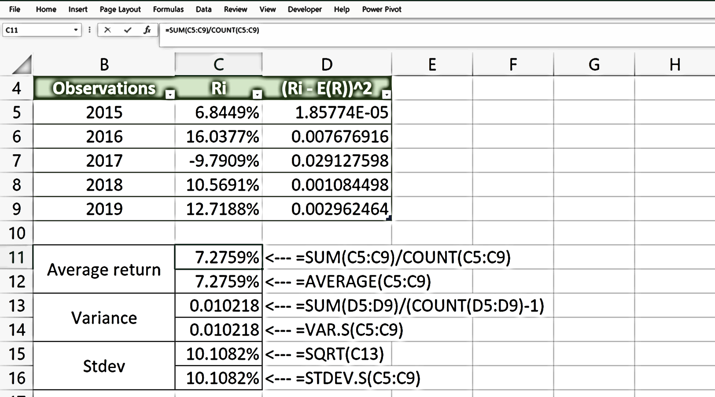
Risk & Return
Risk & Return
Measuring investment return
Measuring investment risk
Chapter 5 of Fundamentals of Financial Management by Van Horne and Wachowicz

Slide 3



Contents
The concept of risk and return on investment.
Measuring return on investment.
Measuring risk associated with returns on investment.
Comparing the risk-return profile of investment options using the coefficient of variation.
Diversification and assessing investment portfolios.

Slide 4
Learning Outcomes
Explain
Compute
Discuss
Explain
Create
Explain the relationship between risk and return.
Compute expected return and the measures of risk (i.e., standard deviation and coefficient of variation) for a single asset and a portfolio.
Discuss investor attitudes toward risk.
Explain the term “diversification” and the benefit of portfolio investment.
Create an effective investment diversification strategy.

Slide 5
Return
Return
Investment income
Capital gains
Return is the reward for investing money.
Return comprises the income received on the investment and any change in market price.

Slide 6
Risk
Risk-free assets
Actual returns on such assets are not different from what is expected.
Government securities are the best proxies for risk-free assets.
Risky assets
Actual returns on such assets are not guaranteed; and so, may differ from what is expected.
E.g., equity stocks.
Risk is the variability of returns from those that are expected.
The concept of risk captures the uncertainty about receiving the expected return on an investment.

Slide 7
Risk and Return
Higher Risk
Higher Return
In principle, a security with higher risk should pay a higher return to its investors.
And a security with lower risk should pay a lower return to its investors.

Slide 8
Measuring Return & Risk
Computation of historical rate of return
Computing expected return
Computing standard deviation
Computing coefficient of variation

Slide 9
Measuring return
Sources of return
Investment income (e.g., dividends, interests, rents).
Change in market price (i.e., the difference between the ending market value and the beginning market value).
Computing rate of return
$$Rate of return=\frac{Investment Income+Change in Price}{Value of Asset Invested}$$
𝑅𝑎𝑡𝑒 𝑜𝑓 𝑟𝑒𝑡𝑢𝑟𝑛=(𝐼𝑛𝑣𝑒𝑠𝑡𝑚𝑒𝑛𝑡 𝐼𝑛𝑐𝑜𝑚𝑒+𝐶ℎ𝑎𝑛𝑔𝑒 𝑖𝑛 𝑃𝑟𝑖𝑐𝑒)/(𝑉𝑎𝑙𝑢𝑒 𝑜𝑓 𝐴𝑠𝑠𝑒𝑡 𝐼𝑛𝑣𝑒𝑠𝑡𝑒𝑑)

Slide 10
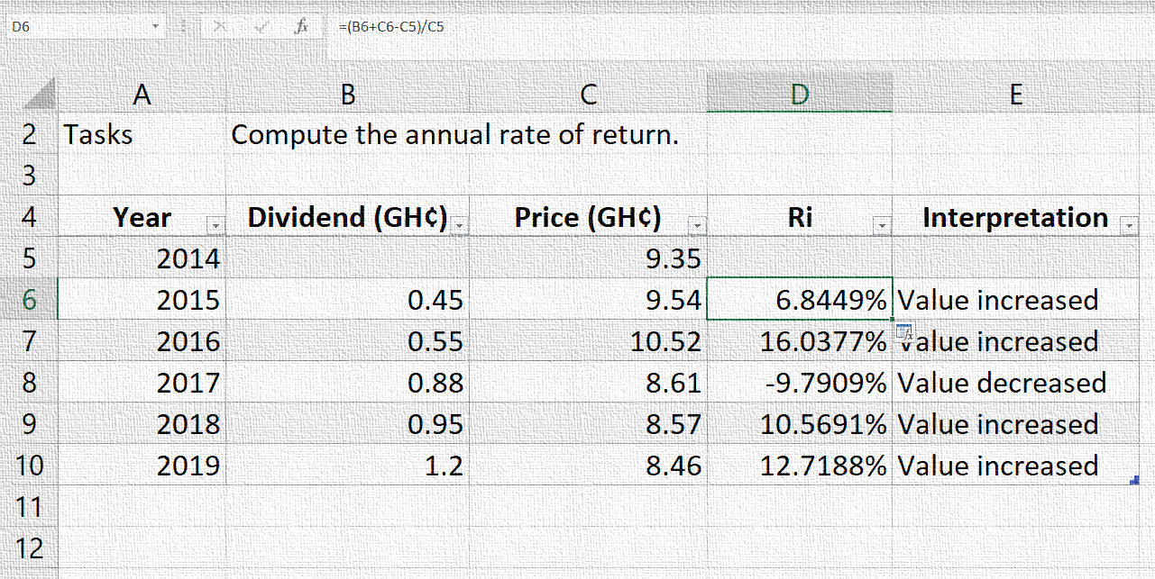
Illustration 1: Measuring return
In this illustration, I explain how to compute annual rate of return from historical data.
← Find the accompanying video for viewing.

Slide 11
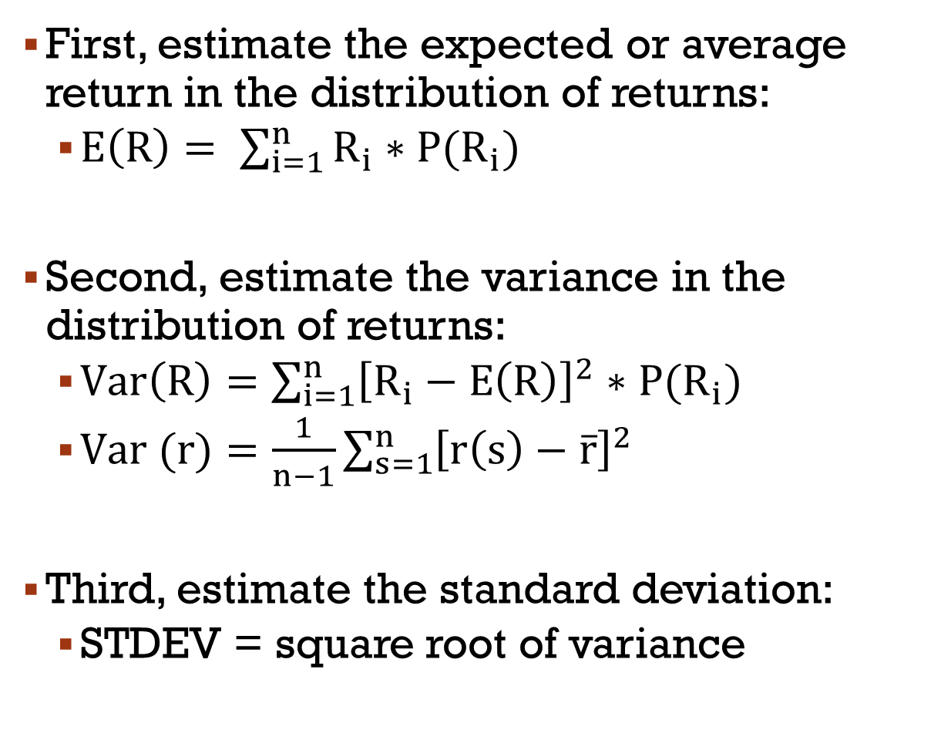
Measuring risk
First, estimate the expected or average return in the distribution of returns:
$E\left(R\right)= \sum_{i=1}^{n}{R_{i}∗P(R_{i})}$
Second, estimate the variance in the distribution of returns:
$Var\left(R\right)=\sum_{i=1}^{n}{{\left[R_{i}−E\left(R\right)\right]}^{2}∗P(R_{i})}$
$Var (r)=\frac{1}{n−1}\sum_{s=1}^{n}{{\left[r\left(s\right)−\overline{r}\right]}^{2}}$
Third, estimate the standard deviation:
STDEV = square root of variance
Risk is measured from a distribution of returns.
The variance and standard deviation are the statistical measures of variability in returns (i.e., risk).
The higher the standard deviation, the higher the variability in returns.

Slide 12
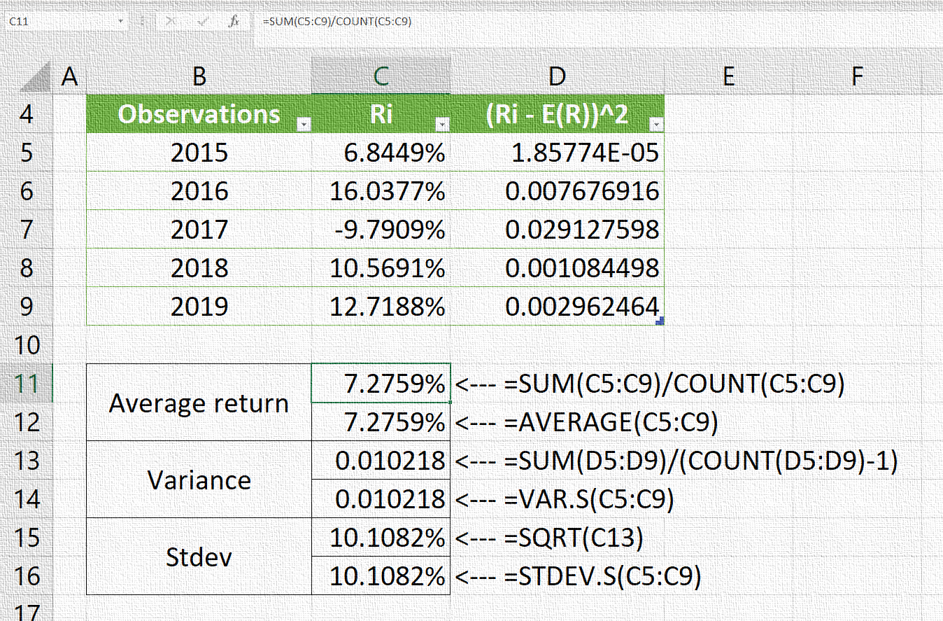
Illustration 2: Measuring risk
In this illustration, I demonstrate the computation of average return and standard deviation from a distribution of historical returns.
← Find the accompanying video for viewing.

Slide 13
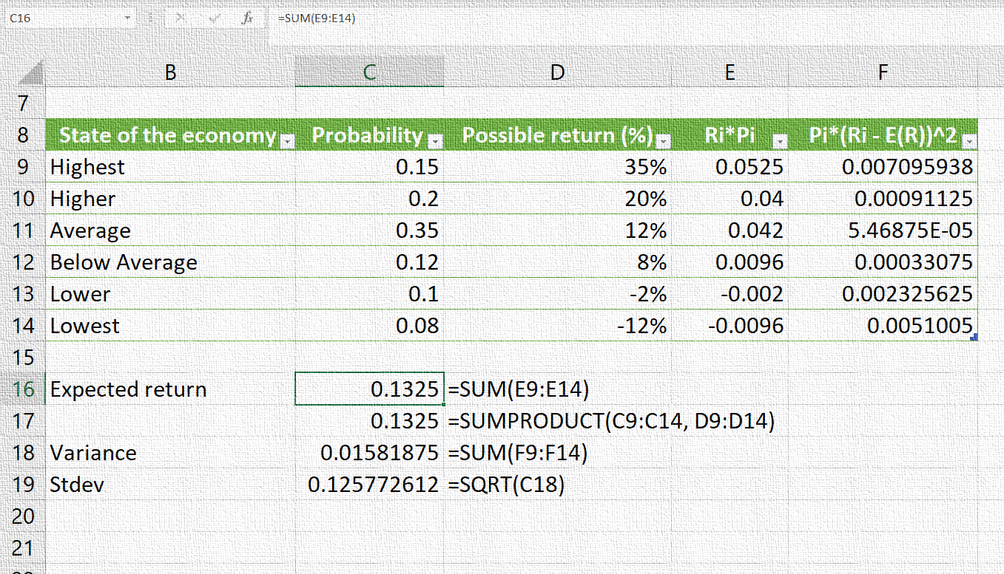
Illustration 3: Measuring risk
In this illustration, I demonstrate the computation of expected return and standard deviation from a distribution of projected returns.
← Find screen recording for viewing.

Slide 14
Using standard deviation information
On the assumption that common stock returns form a continuous distribution, we may estimate the probability of actual return falling within a certain range.
The probability that the stock return falls below the average return is a rough measure of downside risk.
The probability that the stock return goes above the average return is an indicator of upside risk.
Notes:
We’ve worked with a discrete probability distribution of returns to estimate expected return and standard deviation.
However, stock returns typically follow a continuous distribution, one where a random variable (the rate of return in our case) can take on any value within an interval.
On the assumption that common stock returns form a continuous distribution, we may estimate the probability of actual return falling below a minimum or maximum amount.
The probability that the stock return falls below the average return is a rough measure of downside risk.
The probability that the stock return goes above the average return is an indicator of upside risk.

Slide 15
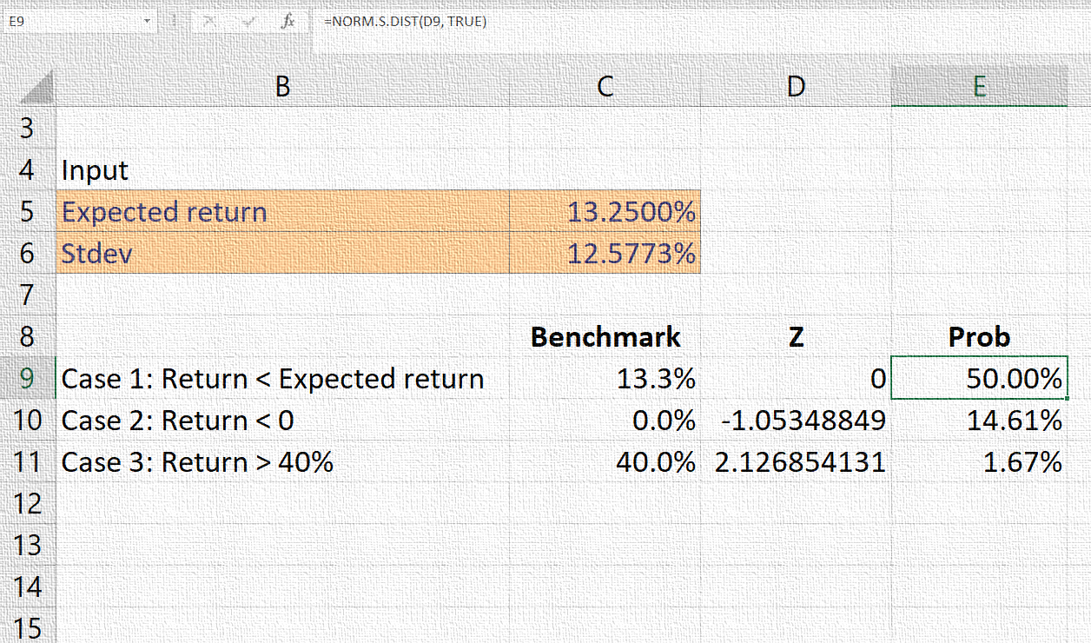
Illustration 4: Estimating probability of a return taking on a value
In this illustration, I demonstrate how to use standard normal distribution to estimate the probability of rate of return taking on a value within an interval.
← Find the accompanying video for viewing.

Slide 16
Comparing risk on different securities
Definition of Coefficient of Variation
A measure of risk per unit of expected return.
Formula for Coefficient of Variation
$$CV=\frac{σ_{R}}{E(R)}$$
CV=σ_R/(E(R))
Standard deviation is an absolute rather than a relative measure.
A relative measure of risk that is appropriate for comparing different assets is the coefficient of variation (CV).
The greater the CV, the higher the risk.
Notes:
Standard deviation is an absolute rather than a relative measure.
A relative measure of risk that is appropriate for comparing different assets is the coefficient of variation (CV).
The greater the CV, the higher the risk.

Slide 17
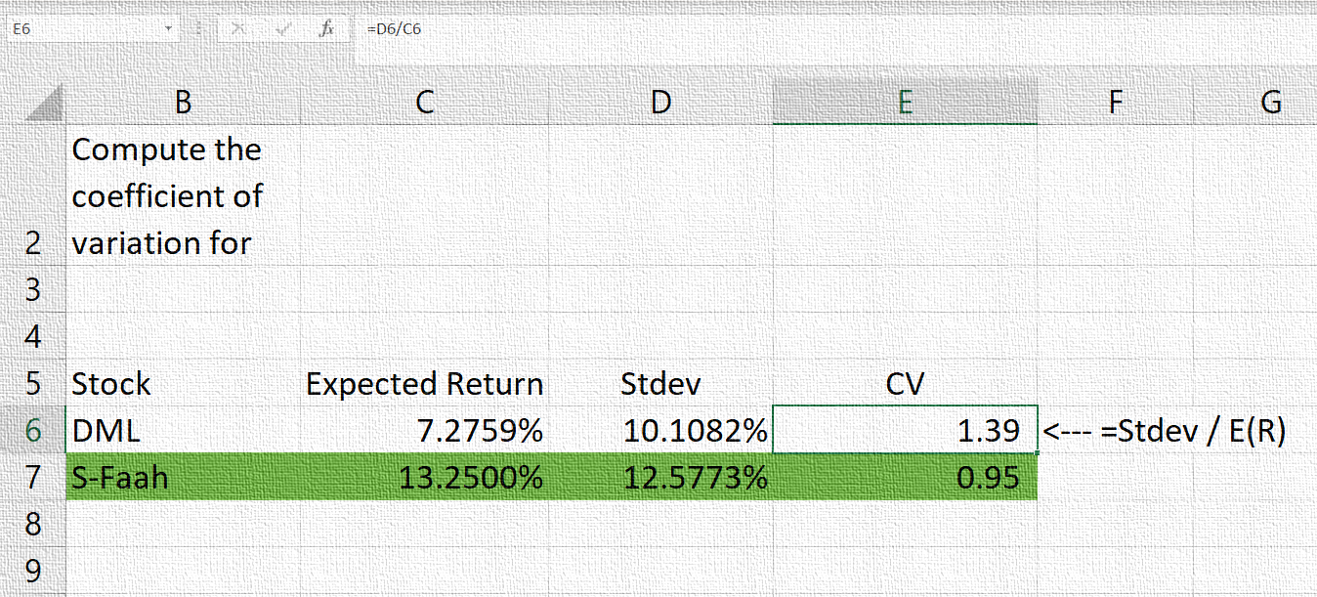
Illustration 5: Computing coefficient of variation
In this illustration, I demonstrate the computation of coefficient of variation.
← Find screen recording for viewing.

Slide 18
Attitudes toward risk
Defining key terms: certainty equivalent and risk aversion
Explanation of risk attitudes: Keep the deal or call of the deal
Worked example

Slide 19
Deal or No Deal!
What would you do?
Walk way with a certain return of GHS2,000
or
Take a risky gamble on the next question with an expected value of GHS3,000 (= 0.5*6,000 + 0.5*0)
Imagine you are in the hot seat of the popular reality show “Who wants to be rich?”.
You have answered several questions successfully and you have accumulated GHS2,000.
The next question is put to you and you have no idea what the correct answer is. And you have exhausted all your lifelines.
You have only two options left: (1) walk away with the GHS2,000 you have accumulated or (2) try your luck on the next question.
If you answer the next question incorrectly, you lose everything and go home with nothing. If you get it right, you go home with GHS6,000 (GHS4,000 in addition to the accumulated GHS2,000).

Slide 20
Certainty equivalent
Definition
The amount of cash someone would require with certainty at a point in time to make the individual indifferent between that certain amount and an amount expected to be received with risk at the same point in time.
Explanation
In the “Who wants to be rich” case, the certainty equivalent is the accumulated amount at a stage in the questioning that is enough for a player to elect to walk away and avoid the risk of getting the next question wrong and losing everything.
So if you choose to walk away with the GHS2,000 you certainly have, then your certainty equivalent is GHS2,000.

Slide 21
Risk aversion
Definition
Demand for higher expected return from an investment when its risk is higher.
Explanation
A risk averse person downgrades the utility from an investment higher below its expected return when risk is higher. Thus, they demand higher expected return to invest in a high-risk securities.
A risk-neutral person is not sensitive to risk; they select investments based only on expected returns.
A risk-loving person raises the utility from an investment higher over the expected returns when the risk is higher. Thus, they are motivated to go for securities with higher risk.

Slide 22
Certainty equivalent and risk attitudes
The relationship between certainty equivalent and the risky expected return can be used to define investors attitude toward risk.
Certainty Equivalent < Expected value, risk aversion
Certainty Equivalent = Expected value, risk indifference
Certainty Equivalent > Expected value, risk preference

Slide 23
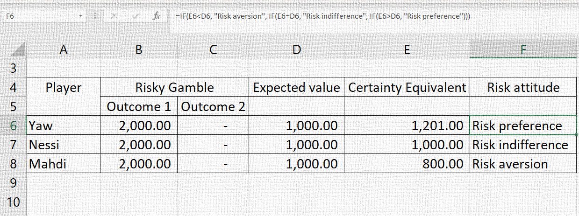
Illustration 6: Attitude toward risk
In this illustration, I demonstrate the computation of expected payoff from a risky gamble and definition of risk attitudes based on the relationship between certainty equivalent and expected value.
← Find screen recording for viewing.

Slide 24
Diversification
The concept of diversification
Creating a well-diversified portfolio
Systematic and unsystematic risk

Slide 25
Diversification to reduce risk
Investors can reduce the risk they take by diversifying their investments.
Diversification is done by holding a portfolio of different investments.
Diversification strategies is supported by the saying that “do not put all your eggs in one basket”.

Slide 26
Computing covariance and correlation
Covariance
$${COV}_{XY}=ρ_{XY}σ_{X}{σ }_{Y}$$
〖𝐶𝑂𝑉〗_𝑋𝑌=𝜌_𝑋𝑌 𝜎_𝑋 〖𝜎" " 〗_𝑌
Correlation
$$ρ_{XY}=\frac{{COV}_{XY}}{σ_{X}σ_{Y}}$$
𝜌_𝑋𝑌=〖𝐶𝑂𝑉〗_𝑋𝑌/(𝜎_𝑋 𝜎_𝑌 )
The covariance and correlation between the returns on the component assets is critical to the effectiveness of diversification.

Slide 27
Towards effective diversification /1
The extent to which diversification can reduce risk depends on the correlation of the returns from the different investments in the portfolio.
For effective diversification, the correlation between the component assets must be negative or low positive.
Correlation can be Positive, Negative, or Zero.

Slide 28
Towards effective diversification /2
To obtain a portfolio with less than perfectly positive correlation:
Invest in different assets (e.g. mixture of shares and bonds)
Invest in different companies
Invest in different industries
Invest in different countries
For effective diversification, the correlation between the component assets must be negative or low positive.

Slide 29
Investment portfolio
Investors hardly put all of their money in a single asset or investment.
Investors usually invest in a portfolio by spreading their money over two or more assets.
The objective of investing in a portfolio is to reduce risk.
A portfolio is a combination of two or more securities or assets.
Notes:
Explanation
Investors hardly put all of their money in a single asset or investment.
Investors usually invest in a portfolio by spreading their money over two or more assets.
The various assets forming the portfolio are referred to as the component assets.

Slide 30
Portfolio Return
General formula
$$E\left(R_{p}\right)=\sum_{j=1}^{m}{W_{j}{\overline{R}}_{j}}$$
𝐸(𝑅_𝑝 )=∑_(𝑗=1)^𝑚▒〖𝑊_𝑗 𝑅 ̅_𝑗 〗
Two-asset portfolio formula
$$E\left(R_{p}\right)=W_{A}{\overline{R}}_{A}+W_{B}{\overline{R}}_{B}$$
𝐸(𝑅_𝑝 )=𝑊_𝐴 𝑅 ̅_𝐴+𝑊_𝐵 𝑅 ̅_𝐵
The rate of return on a portfolio is the weighted average of the rate of returns on the component assets.
In principle, return on a portfolio lies between the minimum and maximum component asset returns.

Slide 31
Portfolio Risk
General formula
$$σ_{p}=\sum_{j=1}^{m}{\sum_{k=1}^{m}{W_{j}W_{k}}}σ_{j,k}$$
σ_p=∑_(𝑗=1)^𝑚▒∑_(𝑘=1)^𝑚▒〖𝑊_𝑗 𝑊_𝑘 〗 𝜎_(𝑗,𝑘)
Two-asset portfolio formula
$$σ_{p}= \sqrt{\left({w_{A}}^{2}\right)\left({σ_{A}}^{2}\right)+\left({w_{B}}^{2}\right)\left({σ_{B}}^{2}\right)+ 2\left(w_{A}\right)\left(w_{B}\right)\left(σ_{A}\right)\left(σ_{B}\right)\left(ρ_{AB}\right)}$$
σ_p= √((〖w_A〗^2 )(〖σ_A〗^2 )+(〖w_B〗^2 )(〖σ_B〗^2 )+ 2(w_A )(w_B )(σ_A )(σ_B )(ρ_AB ) )
Risk on a portfolio is measured by the portfolio standard deviation.
Portfolio risk is not obtained by a simple weighting of the standard deviation of the component assets; it is influenced by covariance between the returns on the component assets.
Covariance is the statistical measure of the extent to which two variables move together.
Notes:
Risk on a portfolio is measured by the portfolio standard deviation.
Portfolio risk is not obtained by a simple weighting of the standard deviation of the component assets; it is influenced by covariance between the returns on the component assets.
Covariance is the statistical measure of the extent to which two variables move together.

Slide 32
The market portfolio
What is the market portfolio?
An investment portfolio comprising of all the stock market securities (excluding risk-free securities), weighted according to the total market value of each security.
For practical reasons, a stock index is used as a proxy for the market portfolio.
The concept of “market portfolio” is important in portfolio theory.

Slide 33
Lecture on Risk & Return
The end

